Slide 1


INTRODUCTION TO RESEARCH
Action Research & Data Analysis
LECTURE 1

Slide 2
What is Research?
Examples of Research Questions:
How can sexual health clinics in district X develop their services and communications to be more LGBT-inclusive?
What are the most effective communication strategies for increasing vaccination rates among those under-30s in region X?
How do the US and the UK compare in health outcomes and patient satisfaction among low-income people with chronic illnesses?
Research is defined as careful consideration of study regarding a particular concern or problem using scientific methods.
According to the American sociologist Earl Robert Babbie, “research is a systematic inquiry to describe, explain, predict, and control the observed phenomenon.

Slide 3
Purpose of Research
Identify potential and new customers, clients or patients
Understand existing customers, clients or patients
Set pragmatic goals
Develop productive market strategies
Address business challenges
Put together a business expansion plan
Identify new business opportunities
Improve outcomes
Inductive research methods analyze an observed event, while deductive methods verify the observed event.
Inductive approaches are associated with qualitative research, and deductive methods are more commonly associated with quantitative analysis.
In health care management Research is conducted to:

Slide 4
Characteristics of Research
Good research follows a systematic approach to capture accurate data.
Researchers need to practice ethics and a code of conduct while making observations or drawing conclusions.
The analysis is based on logical reasoning and involves both inductive and deductive methods.
Real-time data and knowledge is derived from actual observations in natural settings.
There is an in-depth analysis of all data collected so that there are no anomalies associated with it.

Slide 5
Characteristics of Research
Good research creates a path for generating new questions. Existing data helps create more research opportunities.
It is analytical and uses all the available data so that there is no ambiguity in inference.
Accuracy is one of the most critical aspects of research. The information must be accurate and correct.
  For example, laboratories provide a controlled environment to collect data.
  Accuracy is measured in the instruments used, the calibrations of instruments or tools, and the experiment’s final result.

Slide 6
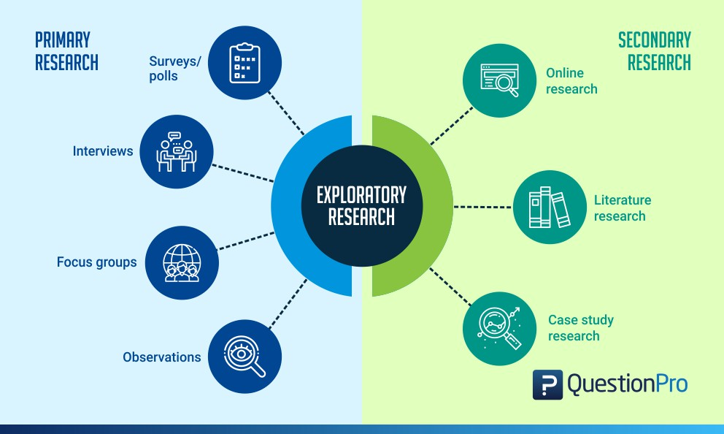
Types of Research
Exploratory
Researchers conduct exploratory studies to explore a group of questions.
The answers and analytics may not offer a conclusion to the perceived problem.
It is undertaken to handle new problem areas that haven’t been explored before.
This exploratory process lays the foundation for more conclusive data collection and analysis.

Slide 7
Types of Research
Descriptive
This research focuses on expanding knowledge on current issues through a process of data collection.
Descriptive research describe the behavior of a sample population.
  Only one variable is required to conduct the study.
The three primary purposes of descriptive studies are describing, explaining, and validating the findings.
  For example, a study conducted to know if top-level management leaders in the 21st century possess the moral right to receive a considerable sum of money from the company profit.

Slide 8
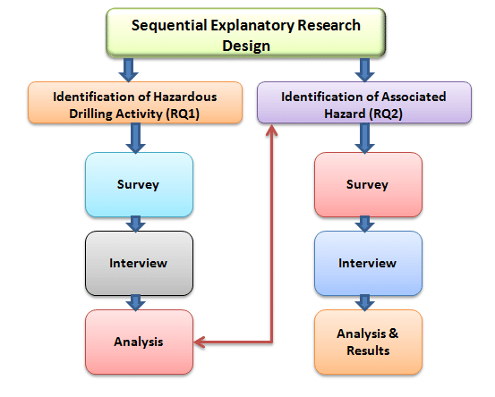
Types of Research
Explanatory
Causal or explanatory research is conducted to understand the impact of specific changes in existing standard procedures.
Conducting experiments is the most popular form.
  For example, a study that is conducted to understand the effect of rebranding on customer loyalty.

Slide 9
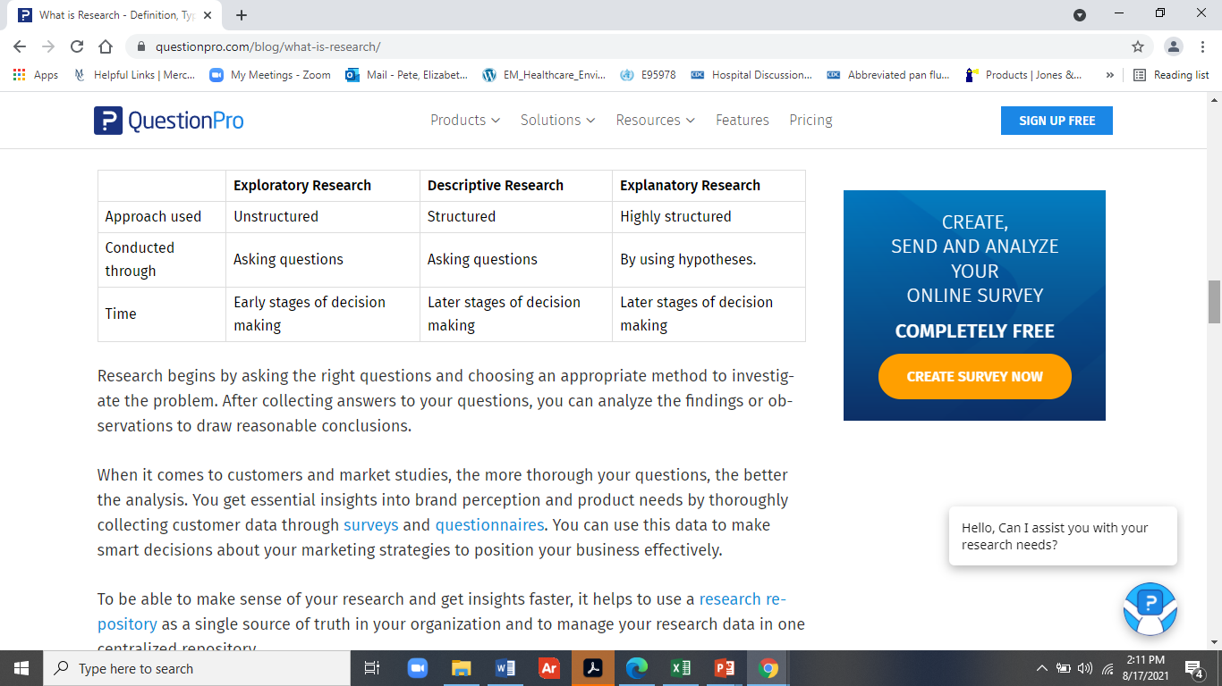
COMPARISON OF TYPES OF RESEARCH

Slide 10
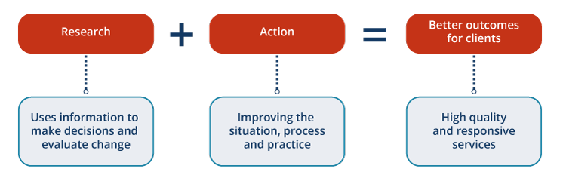
ACTION RESEARCH & PARTICIPATORY ACTION RESEARCH
Action research is a form of investigation designed by health care managers and clinicians to solve problems and improve professional practices.
It involves systematic observations and data collection which can be then used by the practitioner-researcher in reflection, decision-making and the development of more effective service strategies

Slide 11
PARTICIPATORY ACTION RESEARCH & COMMUNITY-BASED PARTICIPATORY ACTION RESEARCH
Participatory Action Research
This research seeks to bring together action and reflection, theory and practice, in participation with others, in the pursuit of practical solutions to issues of pressing concern to people, and more generally the flourishing of individual persons and their communities.
Community-based participatory research (CBPR) is a partnership approach to research that equitably involves community members, organizational representatives, researchers, and others in all aspects of the research process, with all partners in the process contributing expertise and sharing in the decision-making and ownership.
The aim of CBPR is to increase knowledge and understanding of a given phenomenon and to integrate the knowledge gained with interventions for policy or social change benefiting the community members

Slide 12

RESEARCH METHODOLOGY
Research begins by asking the right questions and choosing an appropriate method to investigate the problem.
After collecting answers to your questions, you can analyze the findings or observations to draw reasonable conclusions.
Correct analysis requires using the correct methodology.

Slide 13
RESEARCH METHODOLOGY
Research methods are broadly classified as Qualitative and Quantitative.
Both methods have distinctive properties and data collection methods.
Qualitative methods
Qualitative research is a method that collects data using conversational methods, usually open-ended questions.
The responses collected are essentially non-numerical.
This method helps a researcher understand what participants think and why they think in a particular way.

Slide 14
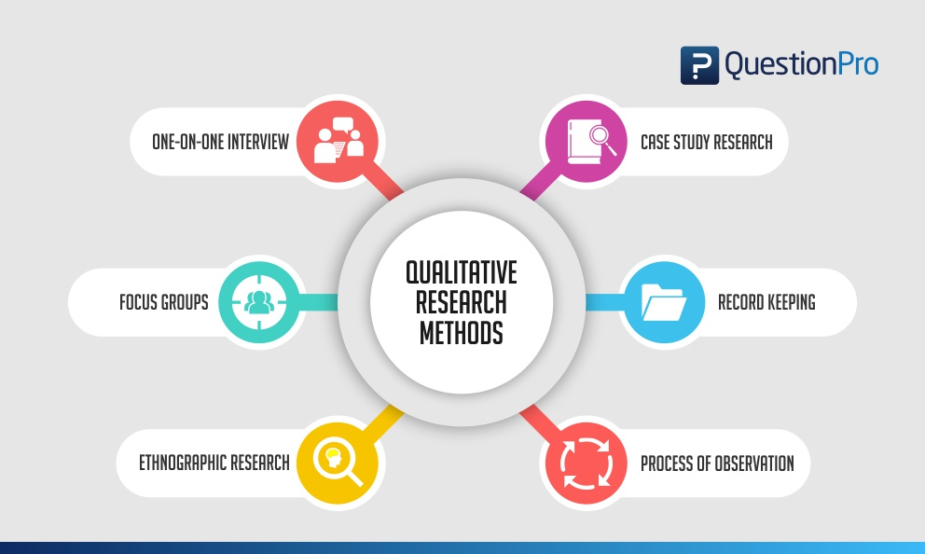
RESEARCH METHODOLOGY
Types of qualitative methods include:
One-to-one Interview
Focus Groups
Ethnographic studies
Text Analysis
Case Study
Record Keeping
Observation

Slide 15
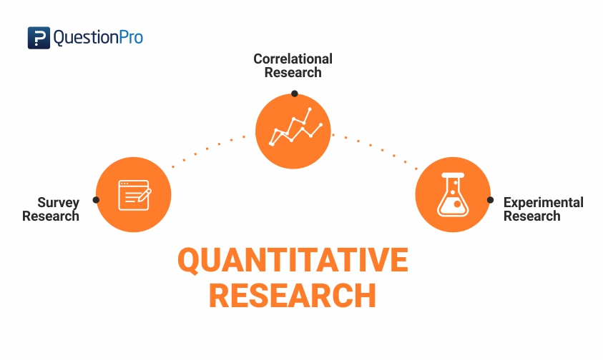
RESEARCH METHODOLOGY
Quantitative methods
Quantitative methods deal with numbers and measurable forms.
It uses a systematic way of investigating events or data.
It answers questions to justify relationships with measurable variables to either explain, predict, or control a phenomenon.
Types of quantitative methods include:
Survey research
Descriptive research
Correlational research

Slide 16
RESEARCH VALIDITY,ACCURACY & RELIABILITY
Research is only valuable and useful if the data it is based on is valid, accurate, and reliable.
It is essential to ensure that research data is:
  Valid – founded, logical, rigorous, and impartial.
  Accurate – free of errors and including required details.
  Reliable – other people who investigate in the same way can produce similar results.
  Timely – current and collected within an appropriate time frame.
  Complete – includes all the data you need to support your business decisions.

Slide 17
THE SCIENTIFIC METHOD
The Scientific Method consists of observing the world around you and creating a hypothesis about relationships in the world.
A hypothesis is an informed and educated prediction or explanation about something.
Part of the research process involves testing the hypothesis, and then examining the results of these tests as they relate to both the hypothesis and the world around you.

Slide 18
THE SCIENTIFIC METHOD
When a researcher forms a hypothesis, this acts like a map through the research study.
It tells the researcher which factors are important to study and how they might be related to each other or caused by a manipulation that the researcher introduces (e.g. a program, treatment or change in the environment).
With this map, the researcher can interpret the information he/she collects and can make sound conclusions about the results.

Slide 19

ACTION RESEARCH & PARTICIPATORY ACTION RESEARCH & THE CAPSTONE PROJECT

Slide 20
USE OF ACTION RESEARCH IN HEALTH CARE
The Capstone project, needed to complete this program, is a proposal for Action research (AR)
AR refers to a wide variety of evaluative, investigative, and analytical research methods designed to diagnose problems or weaknesses—whether organizational, academic, or instructional—and help health care managers, clinicians and others develop practical solutions to address them quickly and efficiently.
An example would be developing an intervention to reduce waiting time for chemotherapy patients by redesigning the process.
AR Creates knowledge based on enquiries conducted within specific and often practical contexts.

Slide 21
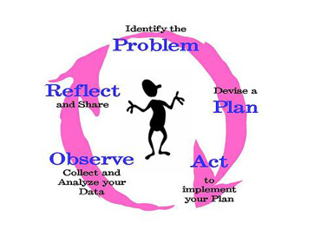
USE OF ACTION RESEARCH IN HEALTH CARE
The purpose of action research is to learn through action (intervention) that improves health outcomes or management for a population, group, institution or community. Key elements of action research are:
  Implementation of an action for improvement to individual practice;
  The use of data collection on the action’s impact
  A review of the action through consideration of data and research;

Slide 22

PARTICIPATORY ACTION RESEARCH
Participatory action research (PAR) is a type of action research
Participatory Action Research (PAR) is an approach to enquiry which has been used since the 1940s.
It involves researchers and participants working together to understand a problematic situation and change it for the better.
It is based on reflection, data collection, and action that aims to improve health and reduce health inequities by involving and empowering the people who receive to take actions to improve their own health access and outcomes.

Slide 23
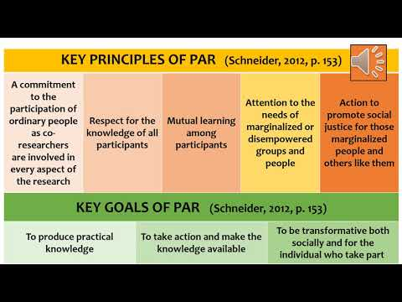
PARTICIPATORY ACTION RESEARCH
PAR researchers work to understand issues from the perspectives of service recipients so they can understand and improve upon the practices
The reflective process is directly linked to action, influenced by understanding of history, culture, and local context and embedded in social relationships.
The process of PAR should be empowering and lead to people having increased control over their lives

Slide 24
PARTICIPATORY ACTION RESEARCH
It focuses on research whose purpose is to enable action.
  Action is achieved through a reflective cycle, whereby participants collect and analyze data, then determine what action should follow.
  The resultant action is then further researched and an iterative reflective cycle perpetuates data collection, reflection and analysis.
PAR differs from conventional research in three ways:

Slide 25
PARTICIPATORY ACTION RESEARCH
2. PAR pays careful attention to power relationships, advocating for power to be deliberately shared between the researcher and the researched:
This blurs the line between them until the researched become the researchers.
The researched cease to be objects and become partners in the whole research process: including selecting the research topic, data collection, and analysis and deciding what action should happen as a result of the research findings.

Slide 26
PARTICIPATORY ACTION RESEARCH
3. PAR contrasts with less dynamic approaches that remove data and information from their contexts.
Most health research involves people, even if only as passive participants, as “subjects” or “respondents”. PAR advocates that those being researched should be involved in the process actively.
The degree to which this is possible in health services research will differ as will the willingness of people to be involved in research

Slide 27
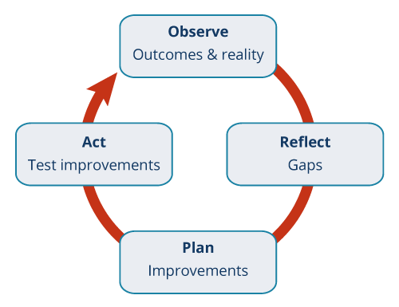
PAR METHODOLOGY
Research methodology is a strategy or plan of action that shapes our choice and use of methods and links them to the desired outcomes.
PAR may use a range of qualitative and quantitative methods.

Slide 28
Community Based Participatory Action Research
To determine if research is or should be PAR– ask the following questions:
Does the research proposal involve the participation of others in planning, gathering data or implementing the intervention?
  If yes, who are the participants (organizations, individuals, community leaders, patients)?
If not, would it be more informative and useful if the research involved representatives from the community, population, workers or intervention site?
– What kind of expertise, information and input might they provide?

Slide 29
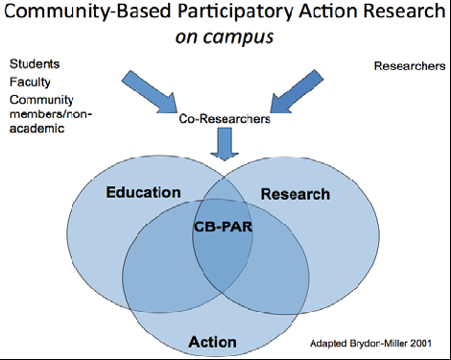
Community Based Participatory Action Research
CBPAR is:
COMMUNITY BASED— grounded in the needs, issues, concerns, and strategies of communities and the community-based organizations that serve them
PARTICIPATORY—directly engaging communities and community knowledge in the research process and its outcomes
ACTION BASED AND ORIENTED —supporting and/or enhancing the strategic action that leads to community transformation and social change

Slide 30
WHAT IS COMMUNITY BASED PARTICIPATORY ACTION RESEARCH
Community Based Participatory Action Research (CBPAR) is a collaborative approach to research that involves all stakeholders throughout the research process.
Collaboration occurs with establishing the research question and continues through developing data collection tools, analysis and dissemination of findings.
It is a research framework that aims to address the practical concerns of people in a community and fundamentally changes the roles of researcher and who is being researched.
The CBPAR framework begins with a community’s issue, proposed action, or strategy and then supports or enhances this action with research that is community based and engaged.

Slide 31
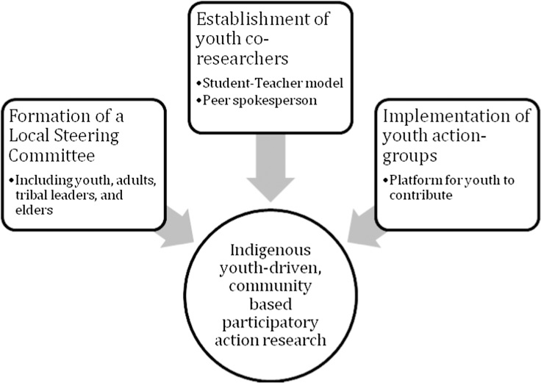
What is Community Based Participatory Action Research
This is an example of a program to engage native American youth.

Slide 32
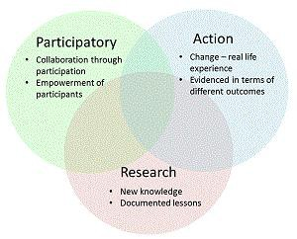
Community Based Participatory Action Research
By its nature, CBPAR is applied research because it seeks to change issues that are critical to communities and focuses on engaging community members in research directed at addressing their concerns.
It is derived from several research approaches that are based on communities collaborating with researchers (ex. Community Based Research), or community members engaging in all aspects of the research process (ex. Participatory Action Research, or Action Research).

Slide 33
The Value of CBPAR
As a framework for research conducted in, for, and by communities, CBPAR recognizes that:
Community knowledge is irreplaceable and provides key insights and access to administrative data
Complex social issues often cannot be well understood or resolved by “expert” research
Interventions from outside of the community have often had disappointing results
Communities should have equal inclusion and collaboration in the identification, research, and resolution of community issues
There is value and legitimacy in the knowledge of individuals, families, and others in the community

Slide 34



Community Based Participatory Action Research
ACTION
RESEARCH
CBPAR has a specific goal of collaborative research that engages stakeholders in an interactive research and action process.
The CBPAR links research and action, recognizing that social action requires further research and social research requires further action.

Slide 35
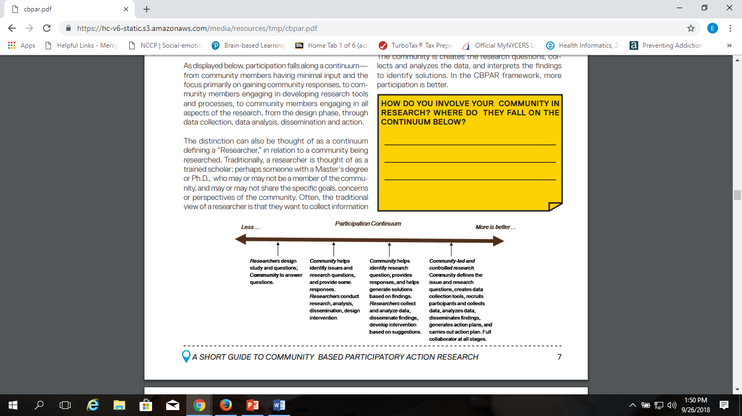
Community Participation and Engagement
Participation falls along a continuum— from community members having minimal input and the focus primarily on gaining community responses, to community members engaging in developing research tools and processes, to community members engaging in all aspects of the research, from the design phase, through data collection, data analysis, dissemination and action.

Slide 36
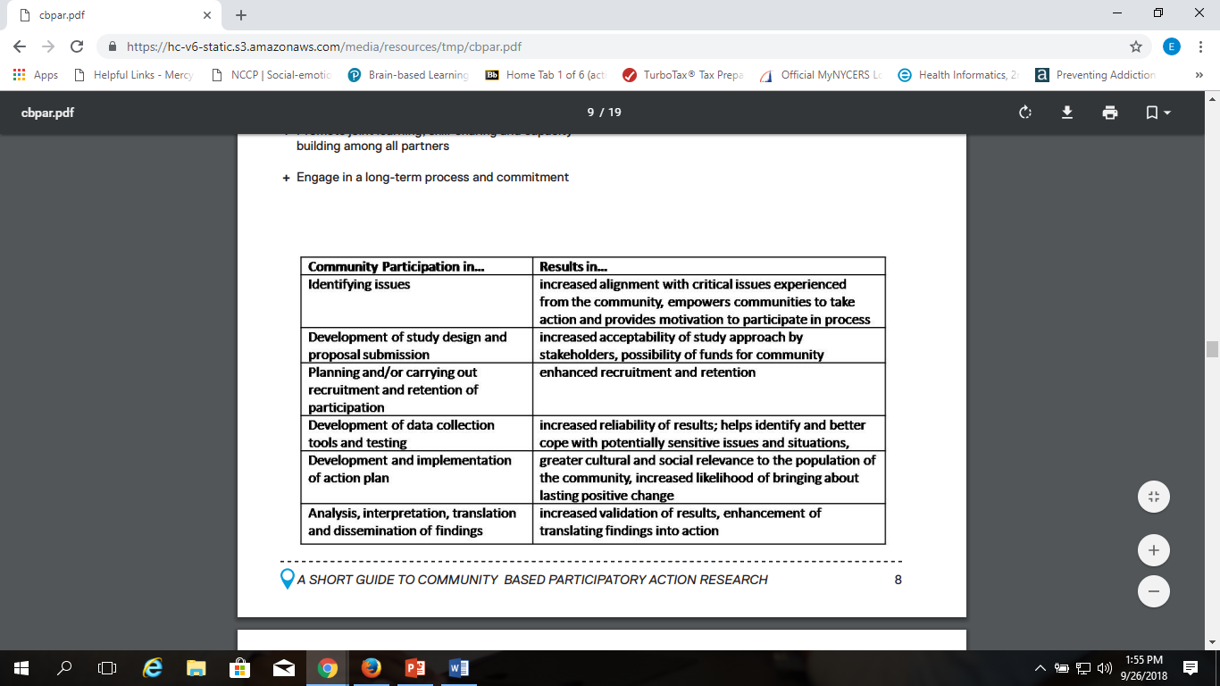
Benefits of CBPAR

